Slide 1

introduction to the initiative
Notes:
Notes for trainer:
This slide set offers child care and early education providers an introduction to the Let’s Move! Child Care initiative.
You can use these slides to train providers. Hold a training on LMCC or integrate LMCC content into existing or new trainings, including in-person and online trainings.
Please feel free to adapt the slides for specific needs and audiences, including adding slides from other LMCC slide sets.
We encourage you to:
Add slides that give information on local resources, training opportunities, and contacts for technical assistance.
Add interactive activities to keep providers engaged and promote learning!
For questions, please email LMCCHelp@cdc.gov.

Slide 2
Learning Objectives
Understand the basics about childhood obesity prevention and why you play an important role
Find out how to participate in the Let’s Move! Child Care initiative to get kids off to a healthy start and be recognized for your efforts
Learn about the resources and tips available on the Let’s Move! Child Care website: www.HealthyKidsHealthyFuture.org

Slide 3
Basics about Childhood Obesity

Slide 4

Obesity Trends* Among U.S. Adults
BRFSS, 1990
(*BMI ≥30, or ~ 30 lbs. overweight for 5’ 4” person)
No Data <10% 10%–14%
Notes:
Suggested talking points:
First, let’s look at obesity trends among adults. This map depicts adult obesity rates.
Note for trainer:
Try pointing out what the rate was in 1990 in the state where you are conducting the training. When you show the next two slides, talk about how the rate in that state has changed.

Slide 5
Obesity Trends* Among U.S. Adults
BRFSS, 2000
(*BMI ≥30, or ~ 30 lbs. overweight for 5’ 4” person)
No Data <10% 10%–14% 15%–19% ≥20%
Notes:
Suggested talking points:
In just 10 years, rates jumped significantly in many states.

Slide 6
Obesity Trends* Among U.S. Adults
BRFSS, 2010
(*BMI ≥30, or ~ 30 lbs. overweight for 5’ 4” person)
No Data <10% 10%–14% 15%–19% 20%–24% 25%–29% ≥30%
Notes:
Suggested talking points:
In 2010, the rates increased even more.

Slide 7
Childhood Obesity
24% – 33% of 2 – 5 year olds are overweight or obese.
Obesity rates for young children doubled in about a 20 year period of time (1980’s – 2000).
Obese children are more likely to become obese adults.
If children are overweight, obesity in adulthood is likely to be more severe.
Notes:
Notes for trainer:
Other statistics to consider sharing include:
According to the 2009 Pediatric Nutrition Surveillance System (PedNSS) data, nearly one-third of the 3.7 million low-income children aged two to four years surveyed were obese or overweight, and 541,000 were obese.
1 of 7 low-income, preschool-aged children is obese.
Some children are burdened more than others. American Indian and Alaska Native (20.7%) and Hispanic (17.9%) children aged 2 to 4 years have the highest rates of obesity.
For more data and statistics, visit: www.cdc.gov/obesity/data/childhood.html

Slide 8
Education Consequences
  Children who are overweight or obese can be undernourished at the same time.
Nutrition deficiencies impair brain development and cognitive functioning, including learning.
Notes:
Suggested talking points:
Foods and beverages associated with obesity (i.e. foods and beverages that are high in fat and high in sugar) often lack important nutrients. Many nutrients are important for brain development and cognitive functioning.

Slide 9
Education Consequences (2)
Physical inactivity
  Children who are not active have more behavioral and disciplinary problems, shorter attention spans in class and do worse in school compared to active children.
Screen Time
  Interferes with exploration, playing, and interaction with others, which promote social development
  Competes with being active, reading, and doing homework

Slide 10
Health Consequences
Obesity increases the likelihood of certain diseases and health problems, such as:
Heart disease
Type 2 diabetes
Cancer
Sleep apnea and respiratory problems
Hypertension
High blood cholesterol
Stroke
Osteoarthritis
Gynecological problems
Liver and Gallbladder disease
Notes:
Suggested talking points:
Obesity is so concerning because obesity puts us at increased risk for many diseases and health problems.
This is especially true for children because the younger you are when you become obese, and the longer you are obese, the greater your risks for having health problems.

Slide 11
Moving Forward
“ … we know the cure for this. This isn't like putting a man on the moon or inventing the Internet - it doesn't take some stroke of genius or feat of technology. ... Rarely in the history of this country have we encountered a problem of such magnitude and consequence that is so eminently solvable.”
Michelle Obama
February 9, 2010
Notes:
Suggested talking points:
The good news is: we CAN solve the obesity problem!

Slide 12
You Play an Important Role
Prevention must start early.
Children spend many hours in your care.
You can provide a healthy environment for children to eat, play, and grow.
  Children who eat nutritious food during every meal stay healthy and have energy to learn.
  Activity promotes brain development, improves sleep, builds self confidence, and reduces stress & depression.
Notes:
Suggested talking points:
If we want to prevent childhood obesity and support children’s healthy development, we have to concentrate on our youngest children and early education and child care providers play a critical role.
Prevention in elementary school aged-children is too late for too many children.

Slide 13
You Play an Important Role (2)
You can help children build healthy habits for life.
  Food preferences and physical activity habits develop during early childhood and continue into adulthood.
  You are a role model. Kids do as you do, especially when they’re young.
You are in a unique position to educate parents and caregivers about healthy eating and activity.

Slide 14


Healthy Kids,
Ready to Learn
Physical Activity
Healthy Eating
Notes:
Suggested talking points:
When kids are active and eat nutritious food, they are healthy and ready to learn!

Slide 15
Participating in Let’s Move! Child Care

Slide 16

What is Let’s Move! Child Care?
Part of the First Lady’s Let’s Move! initiative to raise a generation of healthier kids
Encourages and supports providers to make positive changes in their programs to help children get off to a healthy start
Recognizes providers who meet best practices in 5 goal areas
Notes:
Suggested talking points:
Let’s Move! Child Care (LMCC) is part of First Lady Michelle Obama’s Let’s Move! initiative to raise a generation of healthier kids.
LMCC encourages and supports early education and child care providers to make positive changes in their programs to help children get off to a healthy start.
LMCC encourages providers to focus on meeting best practices in 5 goal areas, and LMCC recognizes providers who meet these best practices.
Participation in LMCC is voluntary.
LMCC is for all types of programs – e.g. family child care homes, centers, Early Head Start and Head Start programs, pre-K, tribal child care programs, and faith-based programs.

Slide 17





5 Let’s Move! Child Care Goals
1 Physical Activity
2 Screen Time
3 Food
4 Beverages
5 Infant Feeding
Notes:
Suggested talking points:
These 5 goals include increasing physical activity, limiting or eliminating screen time, serving healthy food, offering healthy beverages, and supporting infant feeding.
Notes for trainer:
These 5 goals were adapted from “Caring for Our Children: National Health and Safety Performance Standards: Guidelines for Early Care and Education Programs, 3rd edition,” which provides national standards that represent the best evidence, expertise and experience in the country on quality health and safety practices and policies in today’s early care and education settings. Also, screen time standards were adapted from the American Academy of Pediatrics recommendations.

Slide 18
Physical Activity Best Practices
Infants: Short supervised periods of tummy time several times each day
Toddlers & Preschoolers: Active play time every day, both indoor and outdoor
  Toddlers: 60 – 90 minutes or more
  (for half-day programs, 30 minutes or more)
  Preschoolers: 120 minutes or more
  (for half-day programs, 60 minutes or more)

Slide 19
Screen Time Best Practices
Infants: No screen time
Toddlers: No more than 3 – 4 times per year, or never
Preschoolers:
  Only for educational or physical activity purposes
  No more than 30 minutes per week or never, while in your care
  Work with families to ensure no more than 1 - 2 hours per day
Provide screen time reduction and/or media literacy education to parents at least twice a year,
  e.g. special programs, newsletters, or information sheets

Slide 20
Food Best Practices
Toddlers and preschoolers
  Serve a fruit and/or a vegetable at every meal (Juice doesn’t count as fruit, and French fries, tater tots, and hash browns don’t count as vegetables!)
  Limit fried and pre-fried foods
  French fries, tater tots, hash browns, potato chips, frozen and breaded meats or fish to no more than once a month
Preschoolers: Serve all meals family style so that children are encouraged to serve themselves with limited help.
Notes:
Suggested talking points:
Offering healthy food is important, particularly because many children eat most of their daily meals and snacks while in care, especially children in full-time care.

Slide 21
Beverages Best Practices
Water: Visible and available inside and outside for self-serve
Fruit juice: Only100%; limited to no more than 4 – 6 oz. per day per child and encourage parents to support this limit
Sugary Drinks: Never
(includes fruit drinks, sports drinks, sweet tea, and soda)
Milk: Serve only 1% or non-fat (skim) milk to children 2 years and older
(unless otherwise directed by the child’s health provider)

Slide 22

Infant Feeding Best Practice
Have a private room for moms to breastfeed or pump
other than a bathroom
appropriate seating and privacy
Have the space available for mothers who want privacy.
Notes:
Suggested talking points:
There are many ways that programs can support breastfeeding moms and babies. The LMCC infant feeding best practice focuses on one of the ways.
Breast milk is like any other food and should not be present in a bathroom.
It’s ideal to welcome moms who wish to breastfeed in the classroom and to provide a private space for those who wish to use it.

Slide 23
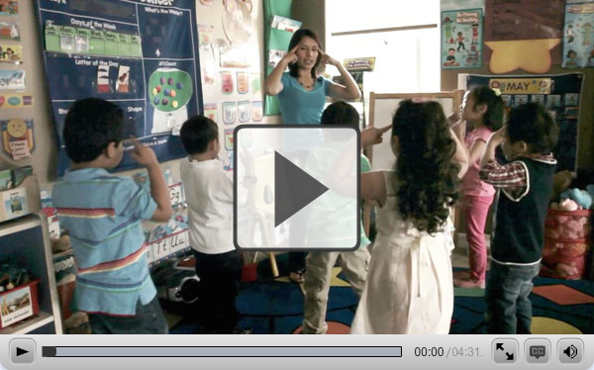
Making Health Easier:
Healthy Changes Start in Preschool
Notes:
Suggested talking points:
This video shows an example of a program that is helping young kids get off to a healthy start.
Notes for trainer:
Play this video during your training session. The video is ~ 4 min.
NOTE: The image on the slide is ONLY an image, not a video.
If you will have internet during your training session, click on the title to show the video.
If you will not have internet during your training session, try embedding the video in your presentation. You can find the video at: www.cdc.gov/CDCTV/ChildObese/index.html
The video is available in Spanish at: www.cdc.gov/CDCTV/ChildObesity_SP/index.html

Slide 24
LMCC Steps to Success
Sign up online at www.HealthyKidsHealthyFuture.org
Take the Checklist Quiz to see how you are doing on the 5 Let’s Move! Child Care goals
Build an Action Plan to reach the goals
Use the free online resources to help implement your action steps
Retake the Checklist Quiz once you meet the goals
Share your success story
Notes:
Suggested talking points:
The first step is to sign up online at www.HealthyKidsHealthyFuture.org. By signing up, you will get LMCC newsletters with new resources, tips, and the latest updates.
Once you sign up, you can take the online Checklist Quiz to see which goals you are meeting and which ones you still need to work toward. The Checklist Quiz is available in English and Spanish.
Then, you can build an action plan to make changes in your program and reach all of the goals.
Use the free online resources to help you make changes.
Once you’ve made changes, retake the Checklist Quiz and record that you’re meeting all of the goals. By doing so, you can become a ‘Recognized Let’s Move! Child Care Provider’.
Share you success. You’re story could be featured on the Let’s Move! Child Care website and help inspire other providers who are working toward the goals.
Notes for trainers:
You can find these steps on the LMCC website at: www.healthykidshealthyfuture.org/home/startearly/howtosignup.html

Slide 25
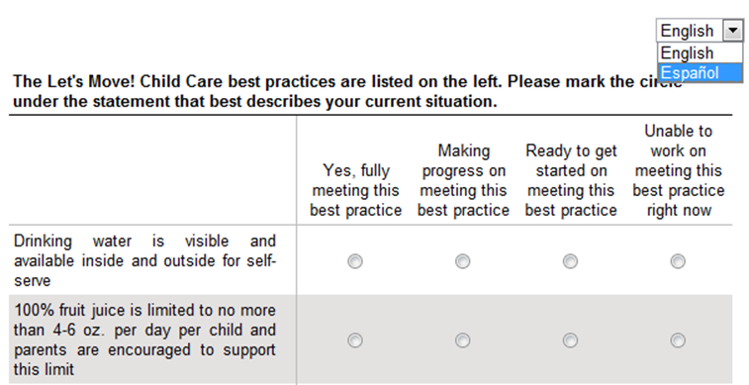
Checklist Quiz: Part 1
Answer questions to see which best practices you are meeting and which goals you need to work on
Available in Spanish too!
Notes:
Suggested talking points:
The Quiz is available in English & Spanish. To take the Quiz in Spanish, click on the drop down menu and select ‘Español’.
The Quiz is tailored to your program! You will only get questions that are relevant to the age groups you serve. For example, if you do not care for infants, you will not get questions about supporting breastfeeding.
This part of the Quiz generally takes 5-10 minutes to complete if you care for infants, toddlers and preschoolers. It takes less time if you do not care for all age groups.

Slide 26
Checklist Quiz: Part 2
Build your action plan
Action Planning is an important step to help you make changes.
You choose your priorities—start with whatever is going to be easiest, then build on your success.
Be ready to create individual action steps.
Sample action plans are available.

Slide 27
Simple Steps
Become a Recognized Let’s Move! Child Care Provider & celebrate your success!
Yes
Sign up
Take Checklist Quiz
Meet all best practices?
No
Build action plan
Make changes
in plan
Use free online resources & tips
Notes:
Suggested talking points:
As a review, here is the process for participating in LMCC.
You can take the quiz as many times as you want!
Remember, once you take the quiz, build an action plan, and make changes, be sure to go back to the LMCC website and re-take the Checklist Quiz to show you’re meeting best practices.
You have to record that you’re meeting all of the best practices to become a Recognized Let’s Move! Child Care Provider!

Slide 28
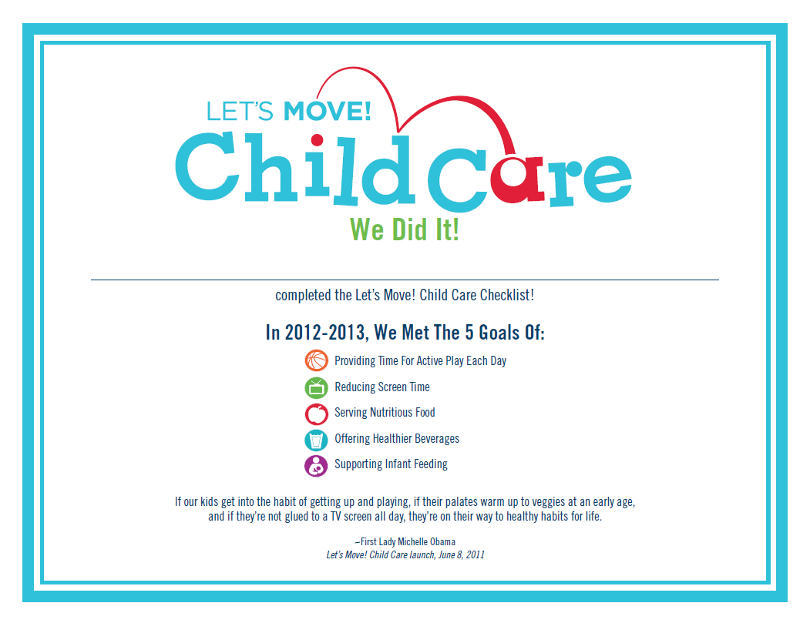
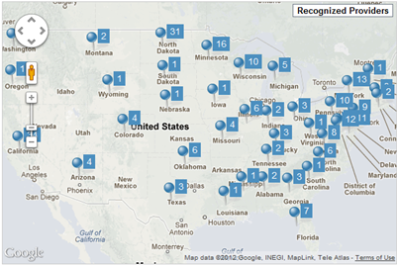
Be a Recognized LMCC Provider!
Get Your
Recognition Award
Be Featured on the LMCC Map
Notes:
Suggested talking points:
Recognized Providers earn a Provider Recognition Award (as shown here on the left). You can display the award in your program or share it with families to let them know what you’re doing to help kids grow up healthy.
Also, Recognized Providers are showcased on the interactive LMCC map on the LMCC website. You can use the map to search for Recognized Programs in your area. This is a useful tool for families who are looking for programs that are promoting children'

Slide 29
Finding resources and tips

Slide 30
What Kind of Resources Can You Find?
Curricula
Training videos
Menu Planning & Recipes
Activity Sheets
Parent Handouts
Tips you can use to eat healthier and be active
And more!

Slide 31
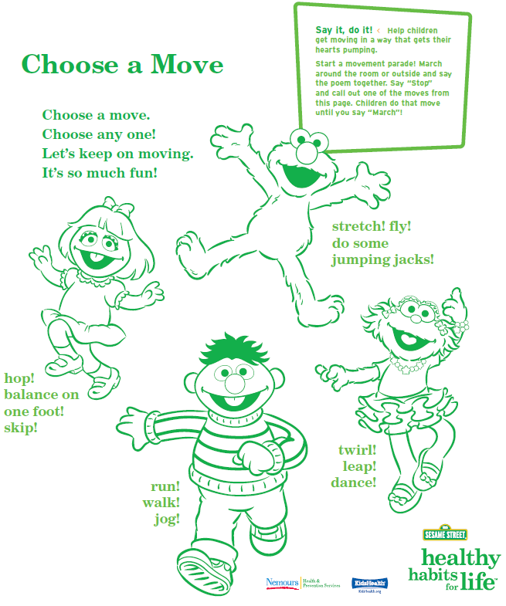

Nutrition & Physical Activity Curriculum (with DVD)
Available in English and Spanish
Notes:
Suggested talking points:
In this nutrition and physical activity curriculum, you will find:
easy-to-use, fun lessons and activities that will fit in with your existing routines;
ways to establish a connection with children’s families so that children continue to practice healthy habits at home.
Notes for trainer:
If you would like to talk more about the curriculum, please find info on the curriculum below. Please note that this language was lifted from the curriculum.
What providers will learn
In order to teach the basic concepts of nutrition and physical fitness to the children in your care, this kit will:
offer information about nutrition and physical activity for young children,
help you to use this knowledge in your group setting, and
present you with exciting options for improving nutrition and increasing physical activity during the course of your day.
What children will learn
Because the greatest learning takes place in an atmosphere of fun, this kit, featuring the Sesame Street friends, is designed to provide an entertaining environment in which children will:
understand the health benefits of eating well and playing actively,
be able to name some healthy foods,
be more likely to try new foods, especially fruits and vegetables,
take part in a variety of physical activities, and
be able to explore at home the lessons they learned in your program.
It’s easy to use. This kit is designed to be used throughout the day and to easily fit into your daily routine. The activities don’t require a lot of time or preparation, and they’re versatile. You’ll find activities for large and small groups, indoor and outdoor learning, and
active and quiet play. Choose the activities that work best for your group.
Section 1, Get Moving! focuses on physical activity and how it builds strong, healthy bodies.
Section 2, Food and Drink to Grow On, highlights ways we can make healthy food choices.
Section 3, Every Day Is a Healthy Day builds upon the first two sections to help children remember what they’ve learned – and celebrate their new knowledge.

Slide 32
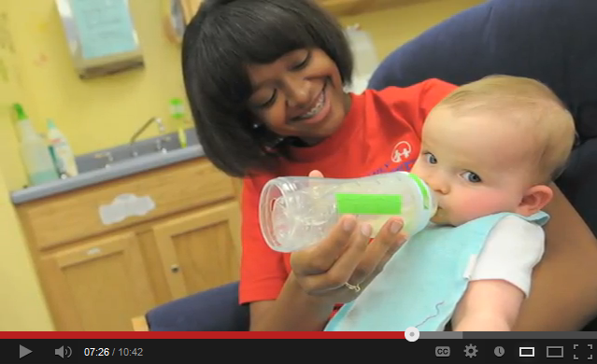
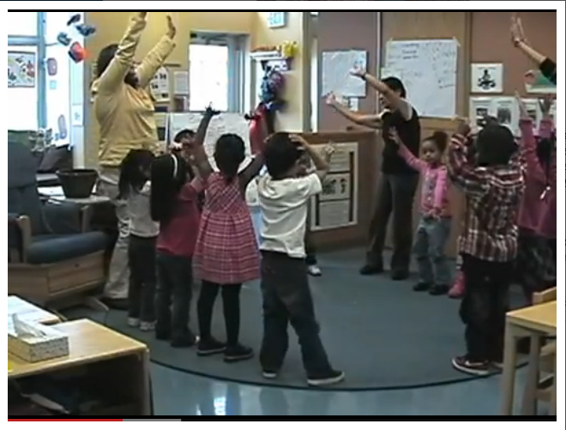
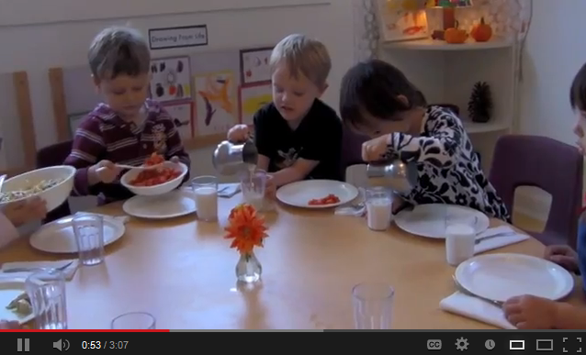
Videos
Supporting Breastfeeding Moms
Adding Physical Activity to Your Daily Routine
Starting Family Style Dining
Notes:
Suggested talking points:
On the website, you can find videos, such as the Motion Moments videos (example shown on the left). These videos offer ideas for incorporating physical activity for babies, toddlers, and preschoolers into your program.
You can find a video on how to support breastfeeding moms (as shown top right).
You can find several videos on how to make family style dining a success in your program (as shown bottom right).

Slide 33
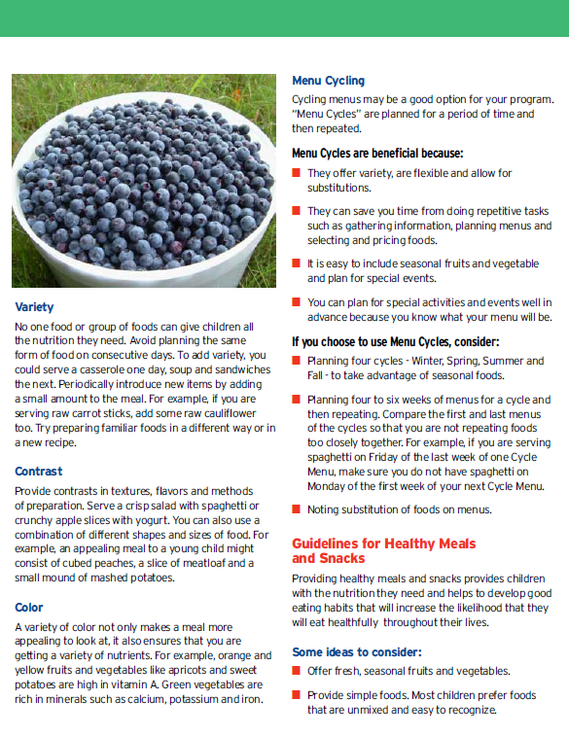
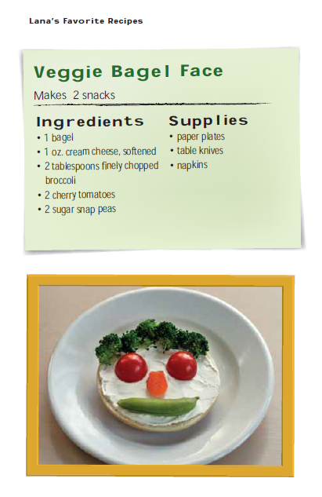
Menu Planning Guide
Kid Friendly Recipes
Notes:
Suggested talking points:
You can find menu planning resources, like this menu planning guide from Child Care Aware of America
You can find recipes that you can make with kids, like this recipe from Lana’s Favorite Recipes.

Slide 34
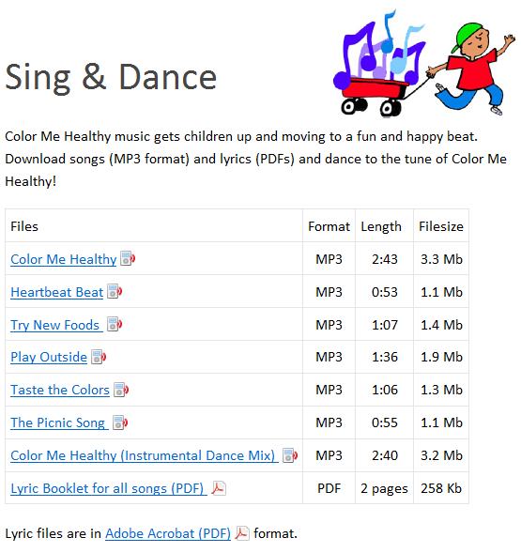
Color Me Healthy music gets kids up and moving to a fun and happy beat!
Notes:
Suggested talking points:
You can find songs that you can download for free. You can download the lyrics too!

Slide 35
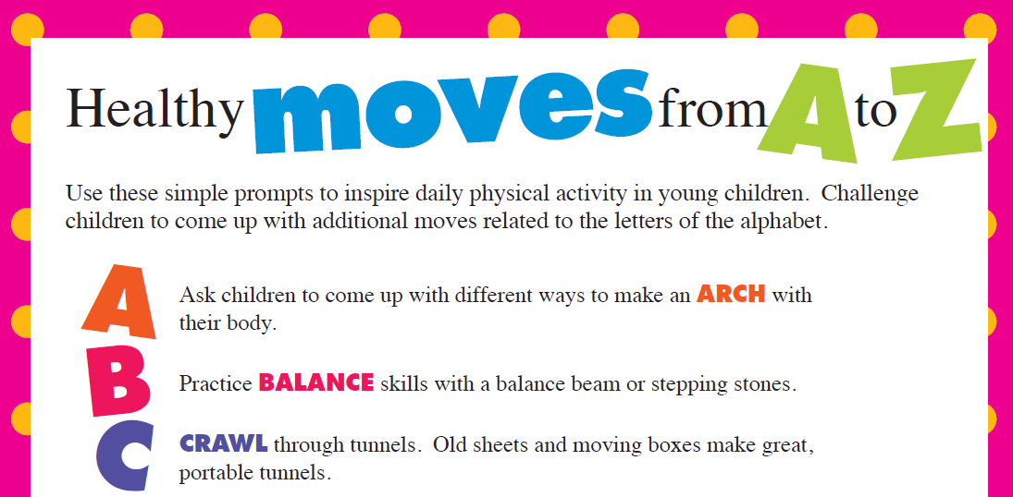

Tip Sheets
Notes:
Suggested talking points:
You can find lots of simple tip sheets like Healthy Moves from A to Z and a Water & 100% Juice Tip sheet (as shown here).

Slide 36

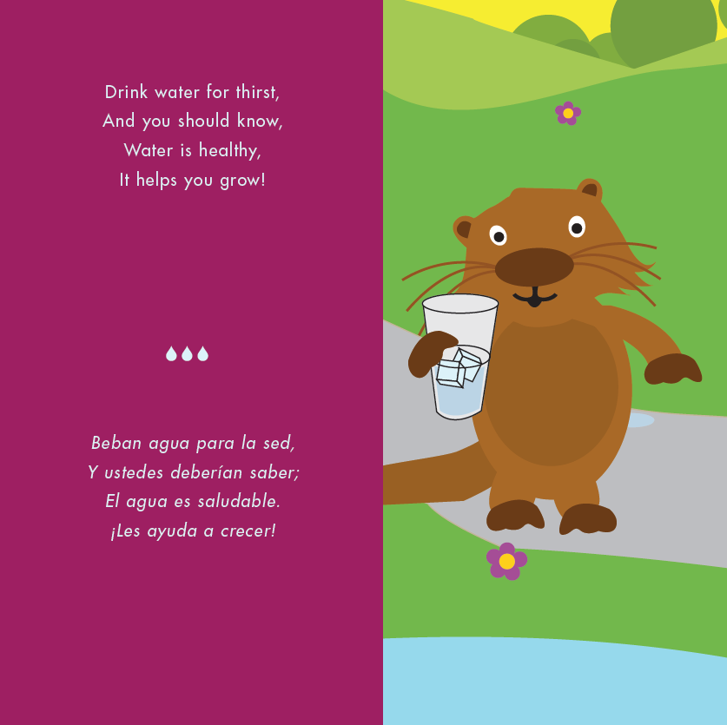
Books to encourage healthy habits
Read this tale about water to your kids!
Notes:
Suggested talking points:
You can find suggestions for books that encourage kids to eat healthy and be active. For example, you can find the link to the Potter the Otter website where you can download the book, Potter the Otter: A tale about water. Potter the Otter loves to drink water and wants kids to love to drink water too!

Slide 37
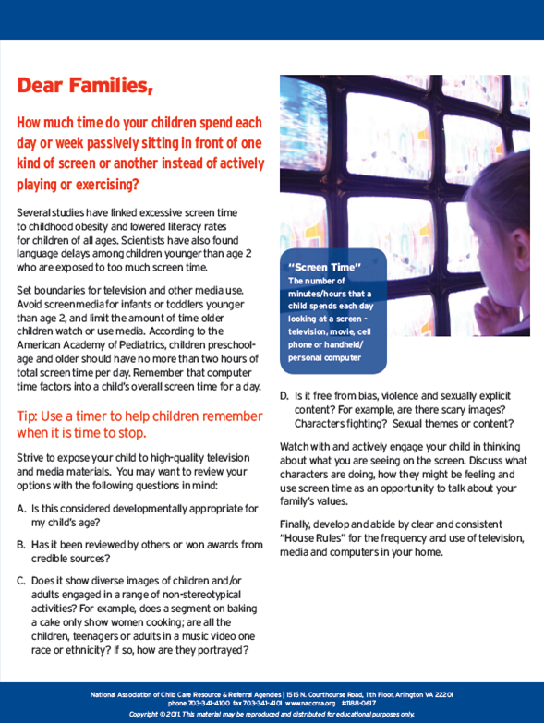
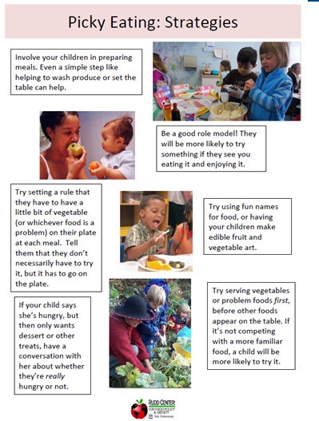
Resources for Families
Letter about Screen Time
Handout on Picky Eating
Notes:
Suggested talking points:
You can find resources that you can share with families, such as this letter that gives ideas on how to limit screen time at home (as shown on the left) and this handout on strategies for encouraging picky eaters to eat their fruits and veggies and other nutritious foods (as shown on the right).

Slide 38
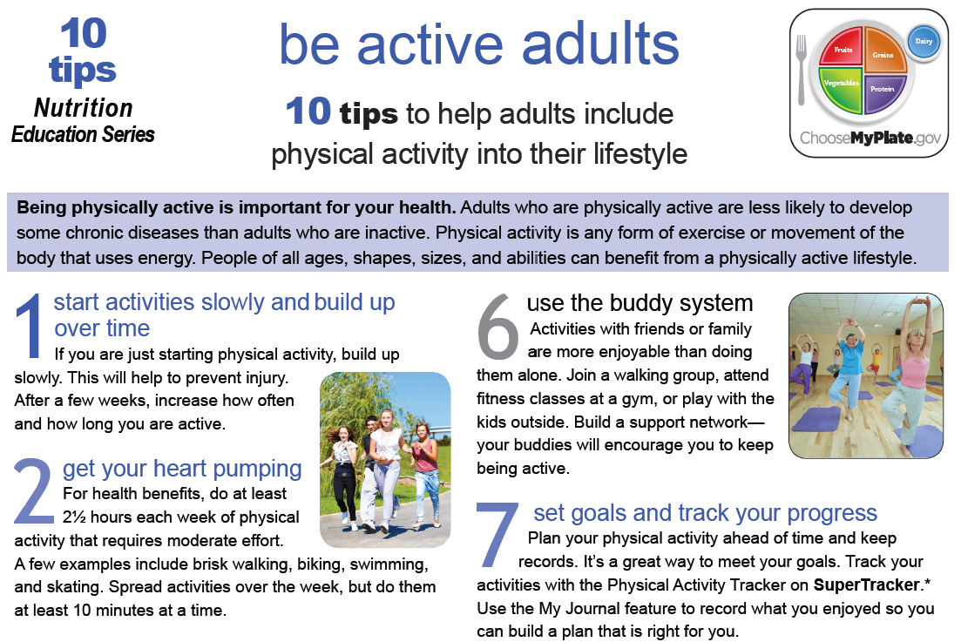
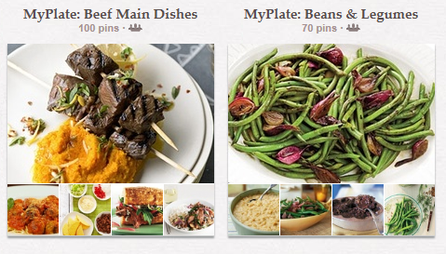
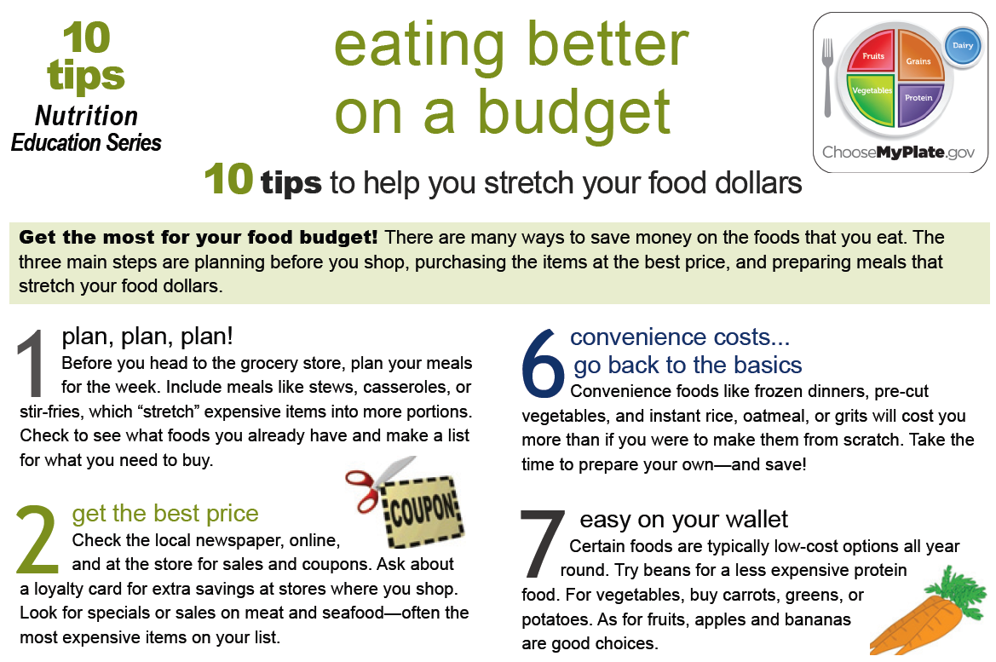
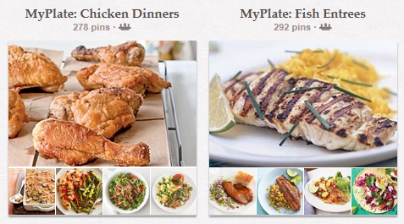
Resources for you!
MyPlate Recipes
on Pinterest
10 Tips Nutrition Education Series from MyPlate
Notes:
Suggested talking points:
The LMCC website has resources for you too! Explore the site to get ideas and resources to help you eat healthier, add physical activity to your day, and be a healthy role model for children.
For example, you can find resources from MyPlate, the new food icon that reminds us to build a healthy plate with vegetables, fruits, whole grains, lean proteins, and fat-free or low-fat dairy at meal time.
Here are two examples of MyPlate resources:
MyPlate has a Pinterest page where you can find hundreds of tasty, good-for-you recipes.
Also, check out MyPlate’s Ten Tips Nutrition Education Series for easy-to-follow tips in a convenient, printable format. These are perfect for posting on a refrigerator. These tips and ideas are a starting point. Choose a change that you can make, and move toward a healthier you.
These tips are available in Spanish too!
These resources are great to share with families too!

Slide 39
Join LMCC & Stay Connected
For more information and to sign up, visit: www.HealthyKidsHealthyFuture.org
Contact the Let’s Move! Child Care Help Desk
LMCCHelp@cdc.gov
Share your success stories!
www.healthykidshealthyfuture.org/home/resources/success.html
Notes:
Suggested talking points:
By signing up, you will get LMCC newsletters with new resources, tips, and the latest updates.
If you have any questions about LMCC, email LMCC at LMCCHelp@cdc.gov.
Notes for trainers:
We’d love to hear your success story too! To share your story, go to www.healthykidshealthyfuture.org/home/resources/success.html and fill out the online form.

